Slide 1
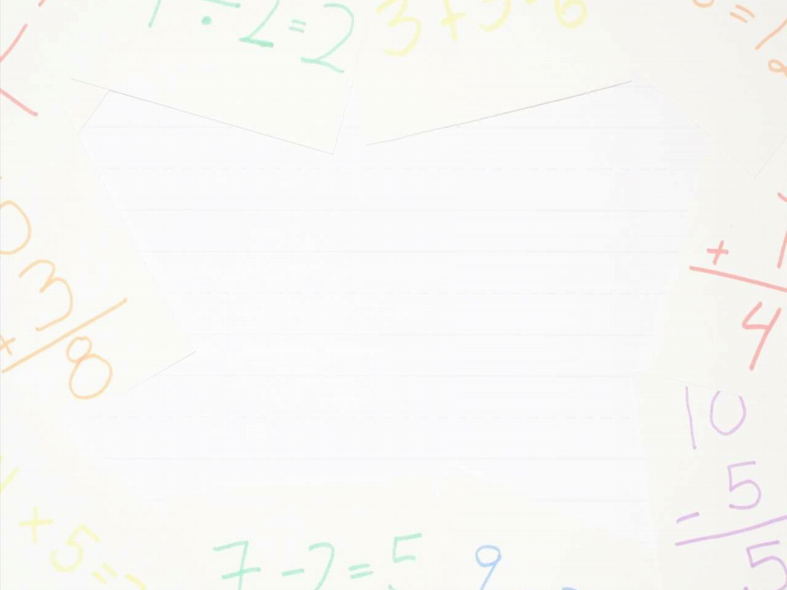

MAT2003-APPLIED NUMERICAL METHODS
Presented by Dr. Mamta Agrawal
•
:
School of Advanced Sciences and Languages,
VIT Bhopal University,
Sehore-466114, M.P., INDIA.
Mamta.agrawal@vitbhopal.ac.in

Slide 2
MODULE-1: Home Work and Activity-1
Algebraic,
& Transcendental equations
Name:
Registration number:

Slide 3
Algebraic and Transcendental Equations
Methods to solve the equations
Direct and Iterative methods

Slide 4
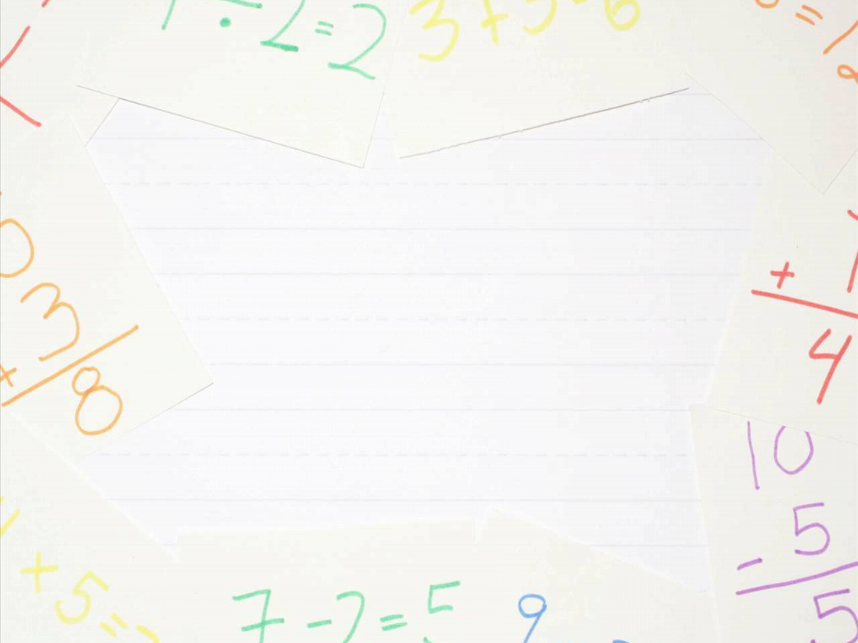

Quiz 1
• This equation $x^{3}−x=1$ is a
Algebraic equation.
Transcendental equation
quadratic equation
Cubic equation

Slide 5

Quiz 2
• This equation$log_{10}\left(x−1\right)$ is a
Algebraic equation.
Transcendental equation
quadratic equation
Cubic equation

Slide 6
EXAMPLE-1: Find the real root of the equation $x^{3}−x=1.$

Slide 7
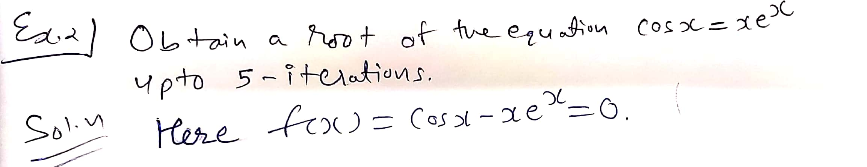




$$x_{0}=0.5$$
$$x_{1}=0.75$$
$$x_{2}=0.625$$
$$x_{3}=0.5625$$
$$x_{4}=0.53125$$

Slide 8
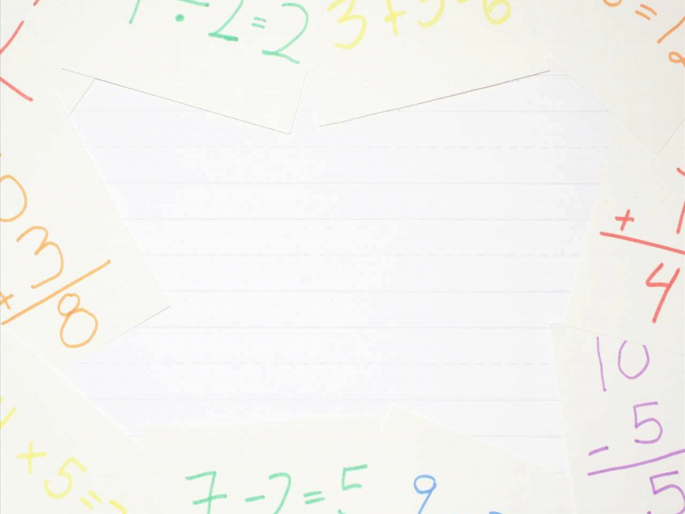
EXAMPLE:3
• Find the real positive root of the equation-
f (x) = x log
x – 1.2
10
Correct upto 3 decimal places.
SOLUTION:
S.No.
a
f (a)
b
f (b)
x
i
f (x )
i
1
2.4
-ve
2.8
+ve
2.6
-ve
2
2.6
-ve
2.8
+ve
2.7
-ve
3
2.7
-ve
2.8
+ve
2.75
+ve
4
2.7
-ve
2.75
+ve
2.725
-ve
5
2.725
-ve
2.75
+ve
2.7375
-ve
6
2.7375
-ve
2.75
+ve
2.74375
+ve
7
2.7375
-ve
2.74375
+ve
2.743625
-ve

Slide 9





Q.4 Solve the following equation for the root by N-R Method. $x_{0}=1.5$
$xsinx−1$=0
$$x_{0}=1.5$$
$$x_{1}=1.051$$
$$x_{2}=1.114$$
$$x_{3}=1.114$$

Slide 10
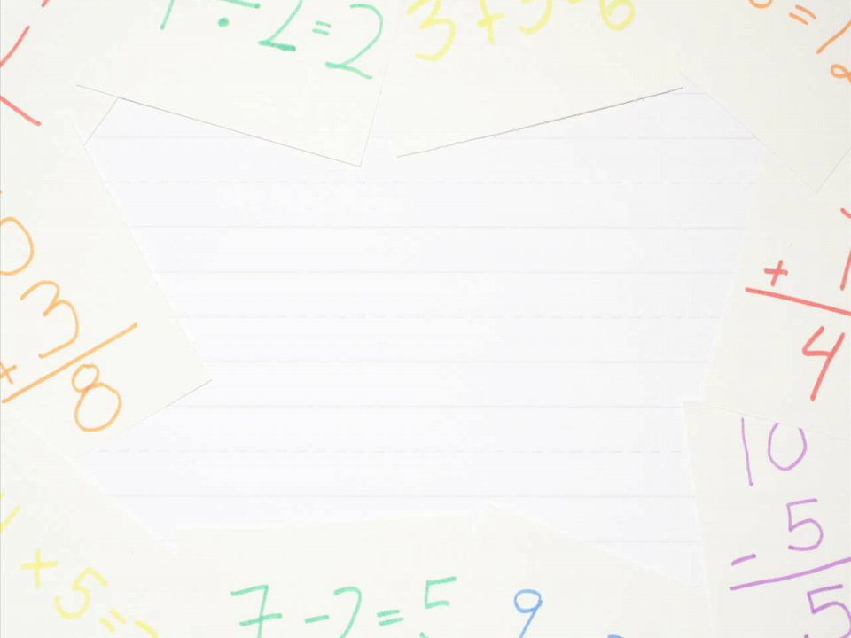
EXAMPLE: 5
1/3
• Find a positive value of (17)
Newton Raphson method.
correct to six decimal places by
SOLUTION:
The root lies between 2.5 and 2.6.
Since, |f (2.6)| < |f (2.5)|
Therefore, the root is nearer to 2.6. Let us take x = 2.58.
Putting n = 0, 1, 2, ..., successively in Newton Raphson’s formula, we
get-
0
x = 2.571311
x = 2.571281
x = 2.5712815
1
2
3
Since x and x are same up to 6 decimal places, hence, the required
Positive root is 2.571281.
2
3

Slide 11
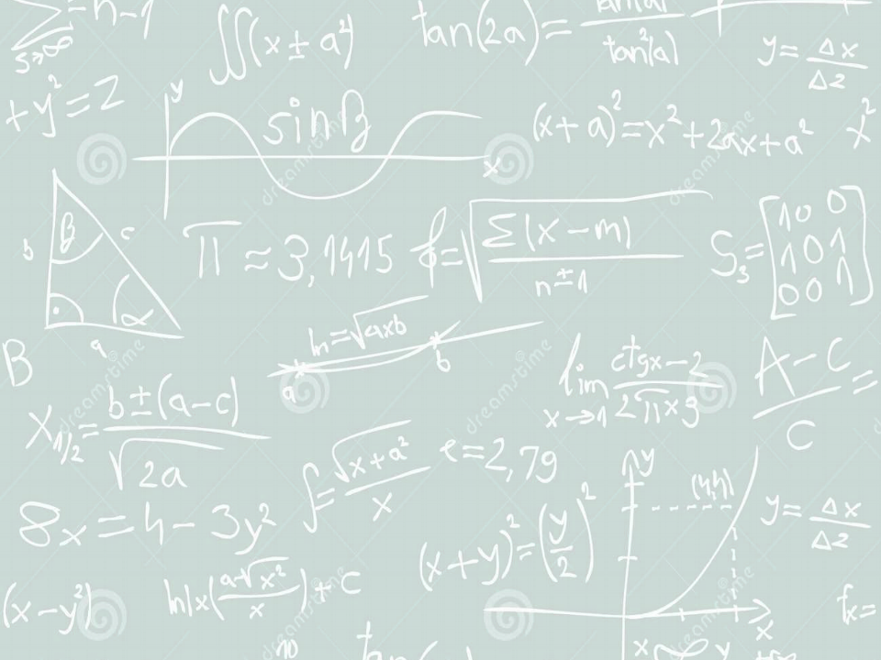
Activity – 1
Solve two quadratic equation
For exact root
For approximate root
Click on the following link for doing this.
You have to submit it in the same PPT.
Please mention your name.
Also solve all above qus 1 to 5 and quiz 1 and 2 in the same ppt.

Slide 12
https://www.youtube.com/watch?v=bpJyJlCnR3g

